Slide 1
Clinical Trial Patient Matching System
LIKITHA chowdary chereddy

Slide 2
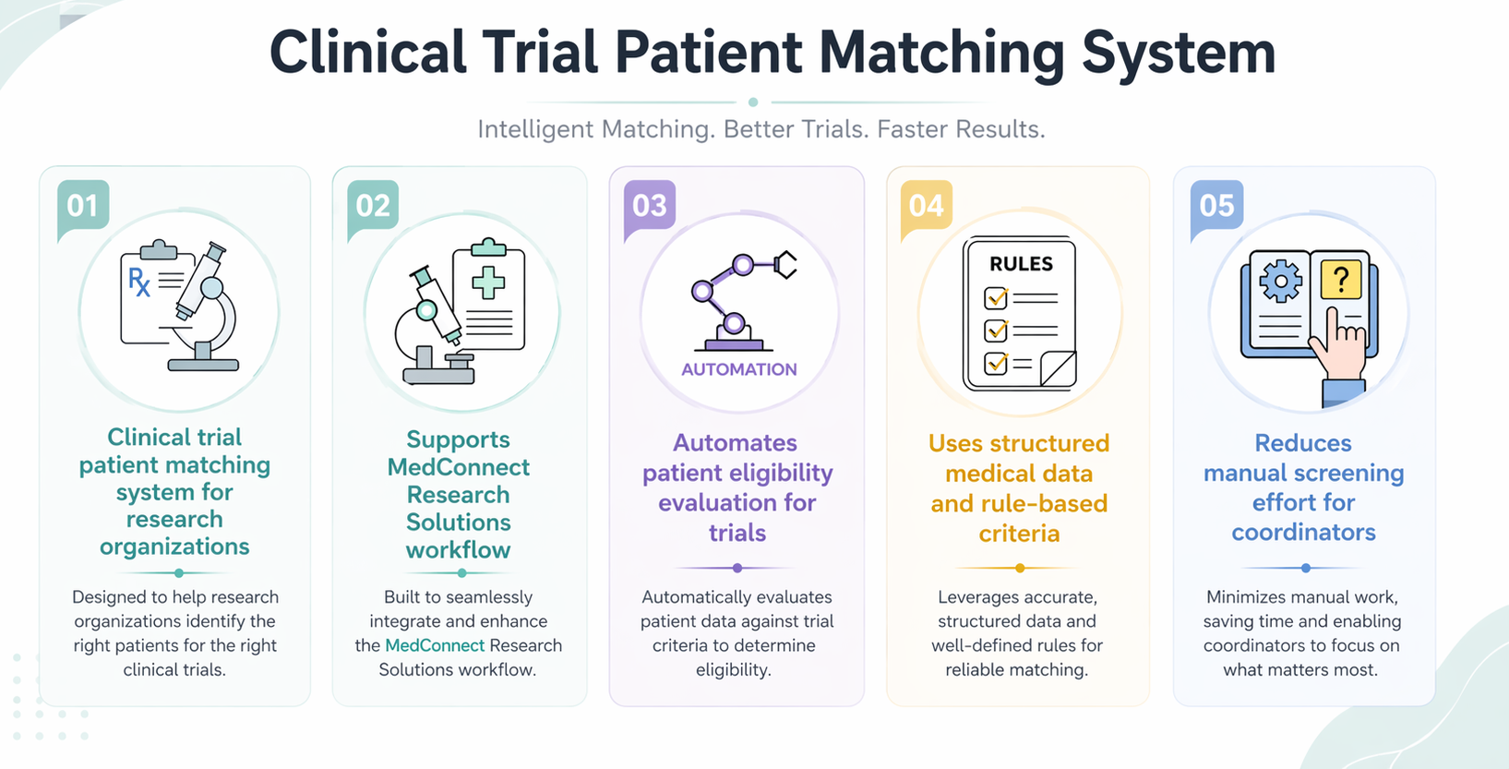
SYSTEM OVERVIEW

Slide 3
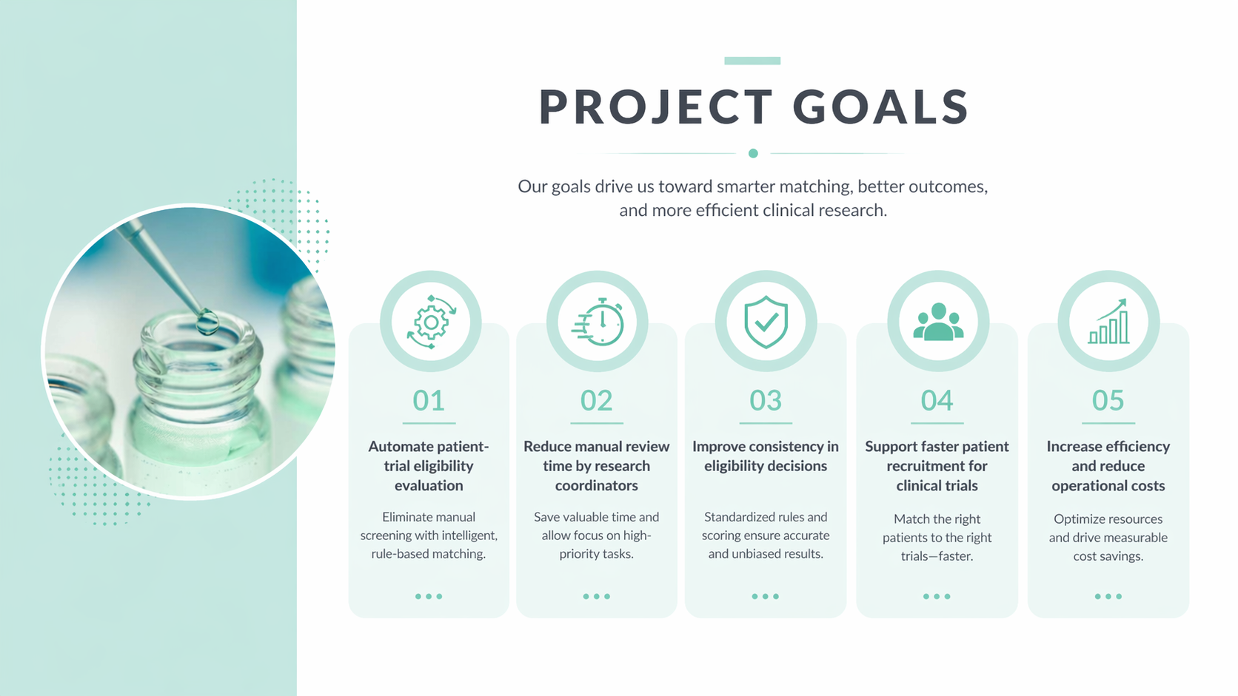

Slide 4
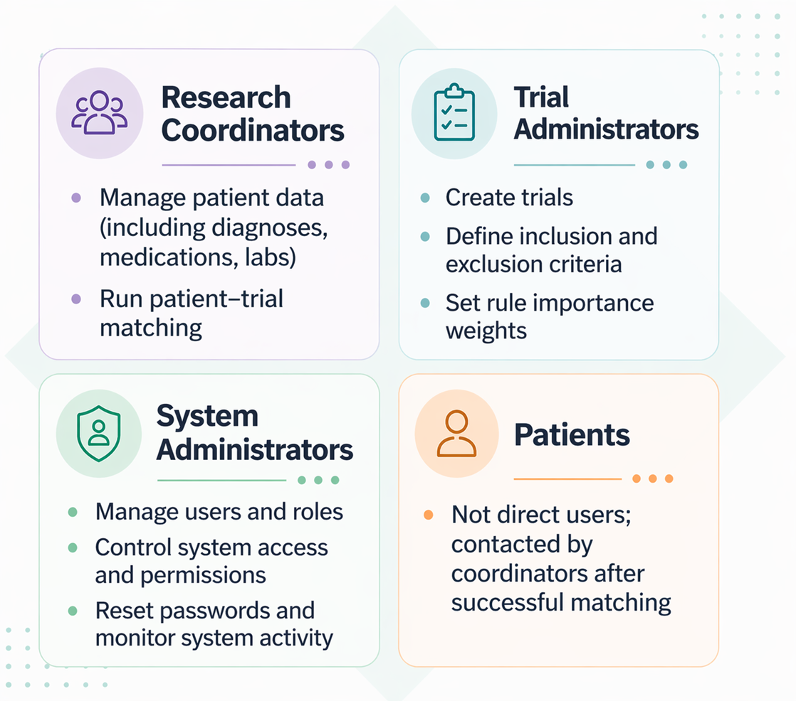
SYSTEM USERS

Slide 5
USER REQUIREMENTS
USER ROLE | KEY REQUIREMENTS
Research Coordinator | Manage patient profiles, enter diagnoses, medications, lab results, and run patient-trial matching
Trial Administrator | Create clinical trials, define eligibility criteria (inclusion & exclusion), assign importance weights
System Administrator | Manage user accounts, assign roles, reset passwords
System (Core Function) | Automatically match patients with trials using rule-based evaluation and generate ranked results
Dependency Relationships:
• Patient data must be created before matching can be executed
• Trial eligibility rules must be defined before evaluation
• Matching results depend on both patient data and trial criteria
• User role permissions control access to system functionalities

Slide 6
CRITICAL NON-FUNCTIONAL REQUIREMENTS
Category | Requirement
Performance | Matching completes within 5 seconds for 1 patient vs 100 trials
Technology | Developed using Python (OOP) as a standalone application
Data Storage | Uses PostgreSQL database with secure storage
Security | Role-based access control for different user roles
Data Protection | Patient data encrypted using strong encryption (AES-256)
Usability | Clear visual indicators for match results (colors, labels)
Audit & Logging | Tracks rule changes, matching actions, and system activities
Data Privacy | Uses only synthetic data, no real patient information stored

Slide 7
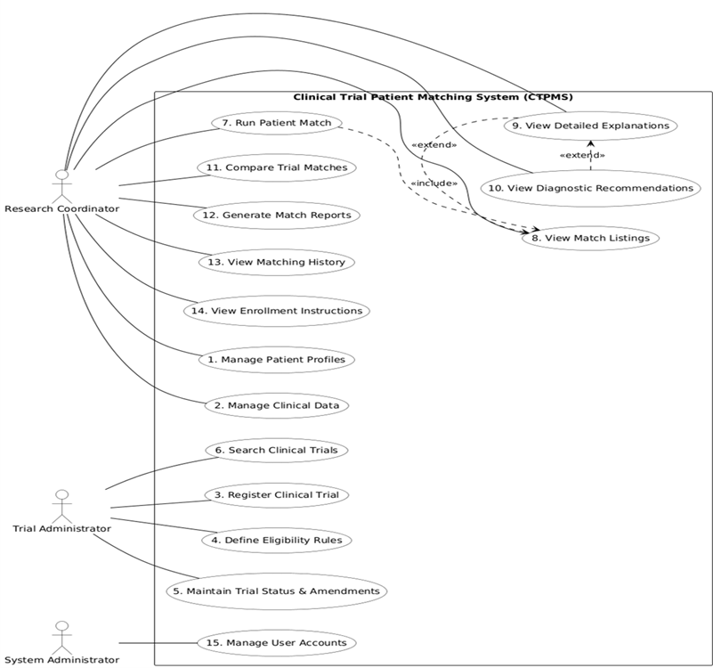
USE CASE DIAGRAM
This diagram shows system users and their actions
Three users: Coordinator, Admin, System Admin
Coordinator runs matching and views results
System provides reports, explanations, and recommendations
This use case diagram is derived from user requirements and defines all system functionalities available to each user role.

Slide 8
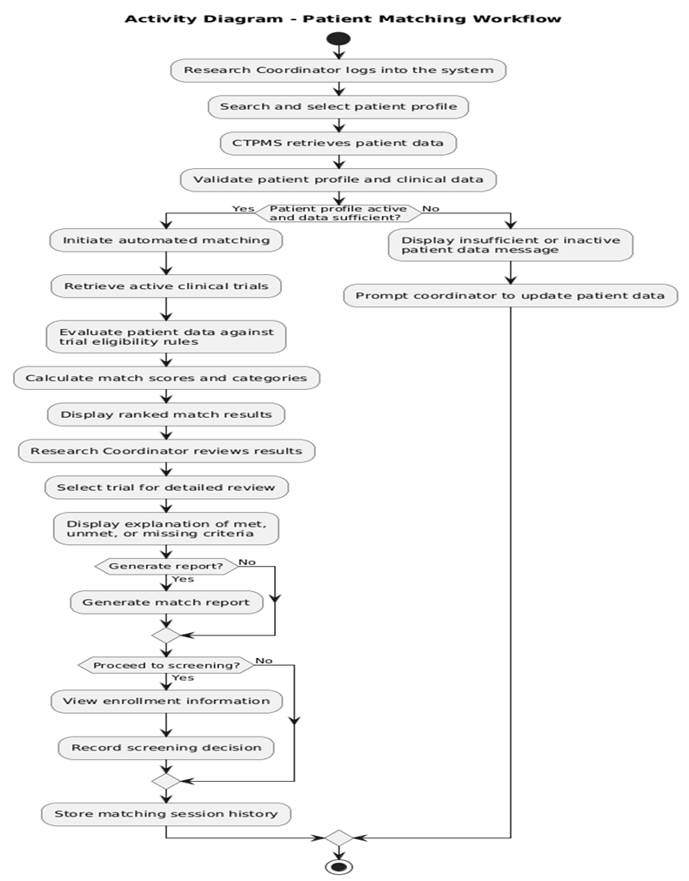
ACTIVITY DIAGRAM
It explains patient matching working flow
Shows step-by-step flow of patient matching process
Helps understand system logic from input to final results
Identifies decision points like data validation and screening
Useful for designing backend logic and workflow implementation
This activity diagram expands the patient matching use case into a step-by-step workflow showing decision points and system logic.

Slide 9
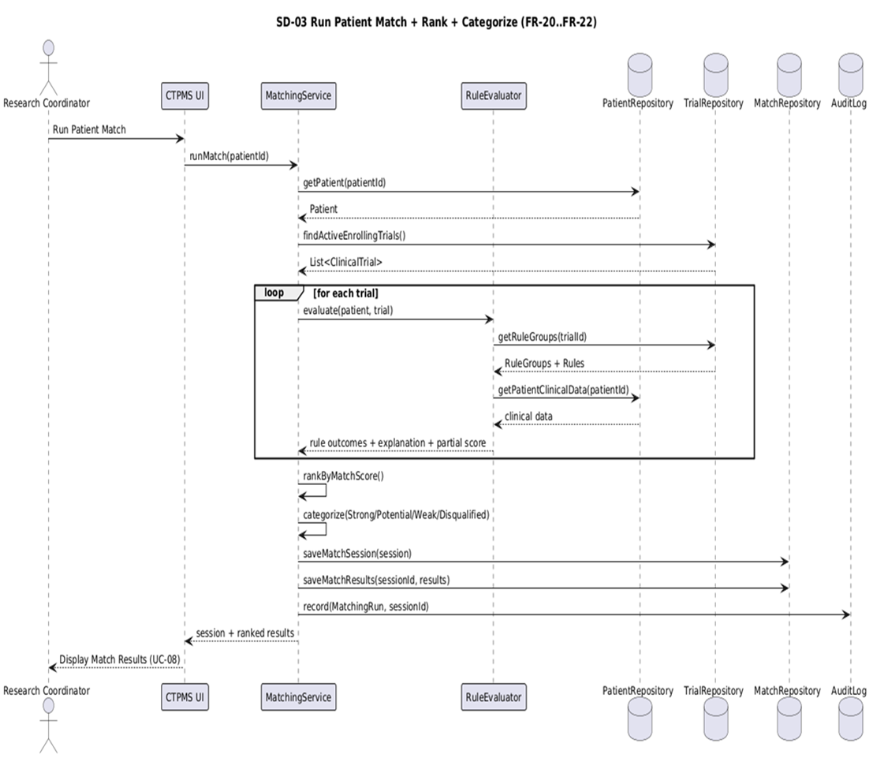
SEQUENCE DIAGRAM
Shows how system components interact step-by-step during patient matching
Illustrates data flow between UI, services, and database repositories
Helps design backend logic like evaluation, scoring, and result storage
Ensures clear structure for implementing matching, ranking, and categorization
This sequence diagram shows how system components interact during the execution of the patient matching use case.

Slide 10
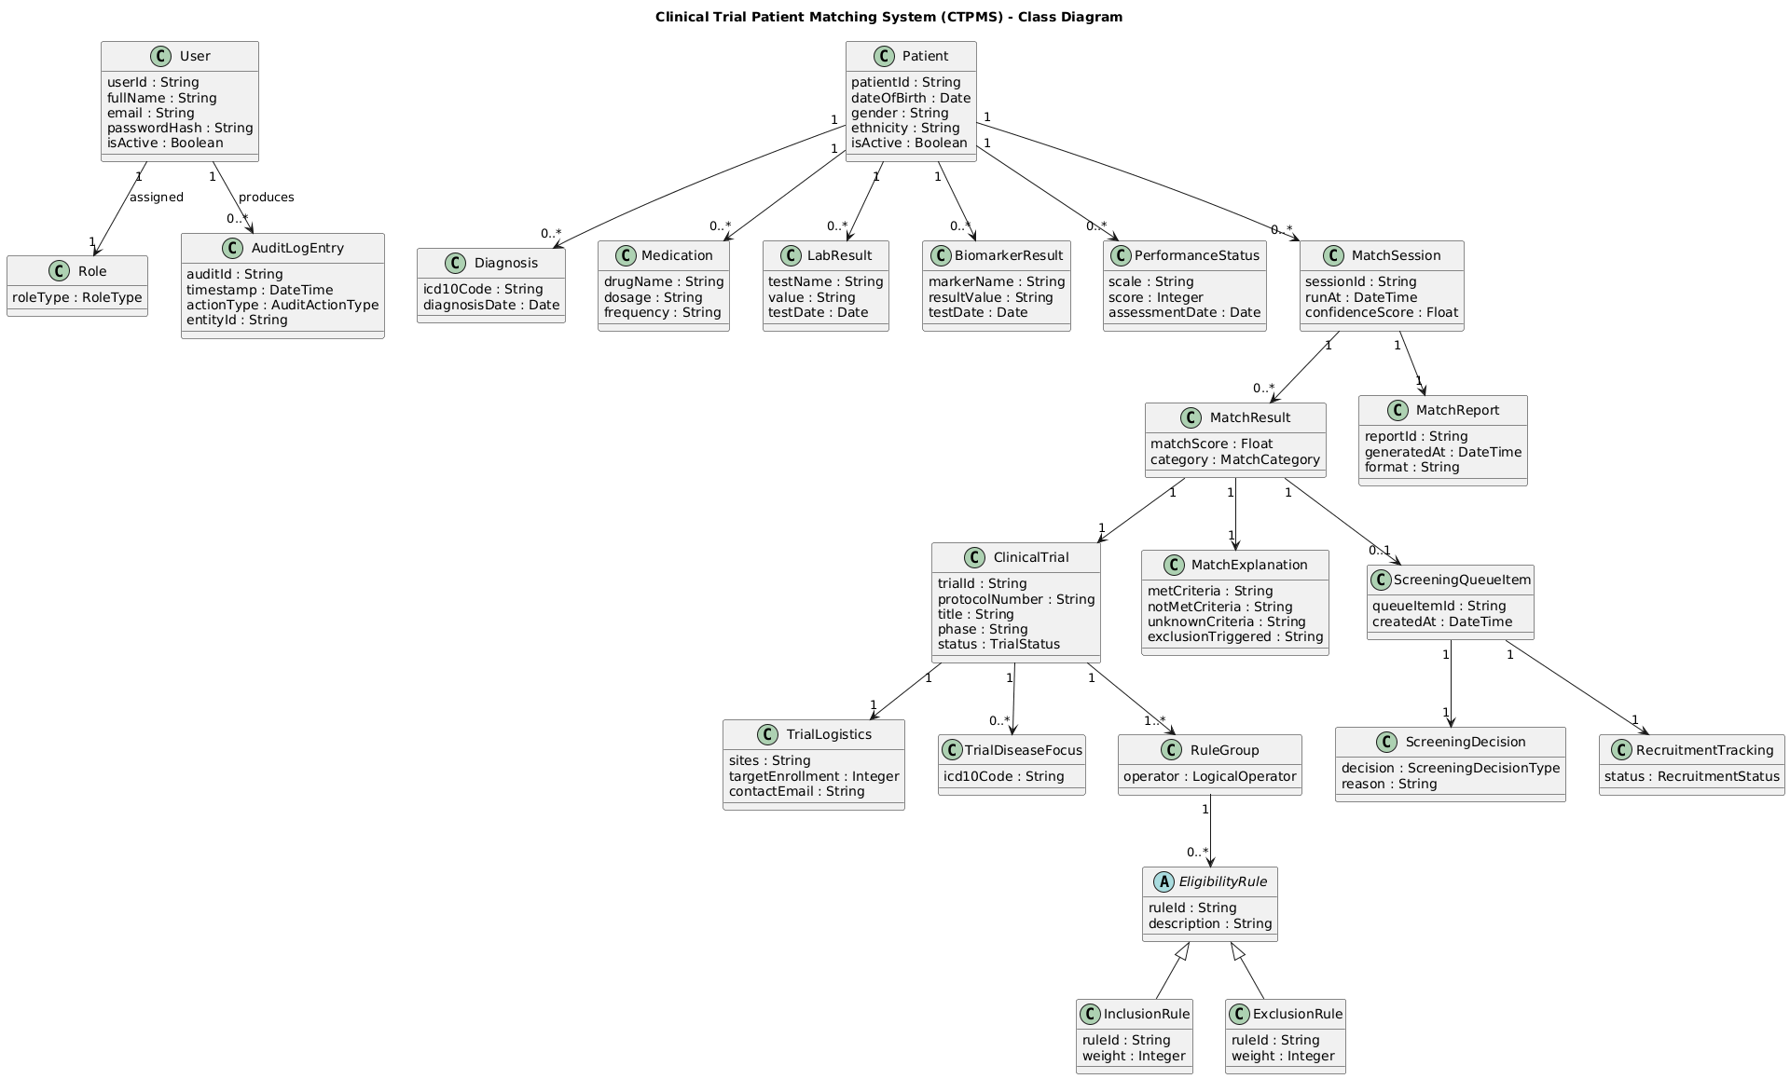
CLASS DIAGRAM
Shows main system entities like Patient, Trial, Match, and User
Defines relationships between data (patient → diagnosis, trial → rules)
Helps design database tables and backend models
Ensures clear structure for implementing matching logic
The class diagram is derived from system entities identified in use cases and defines the structure of the database and application models.

Slide 11
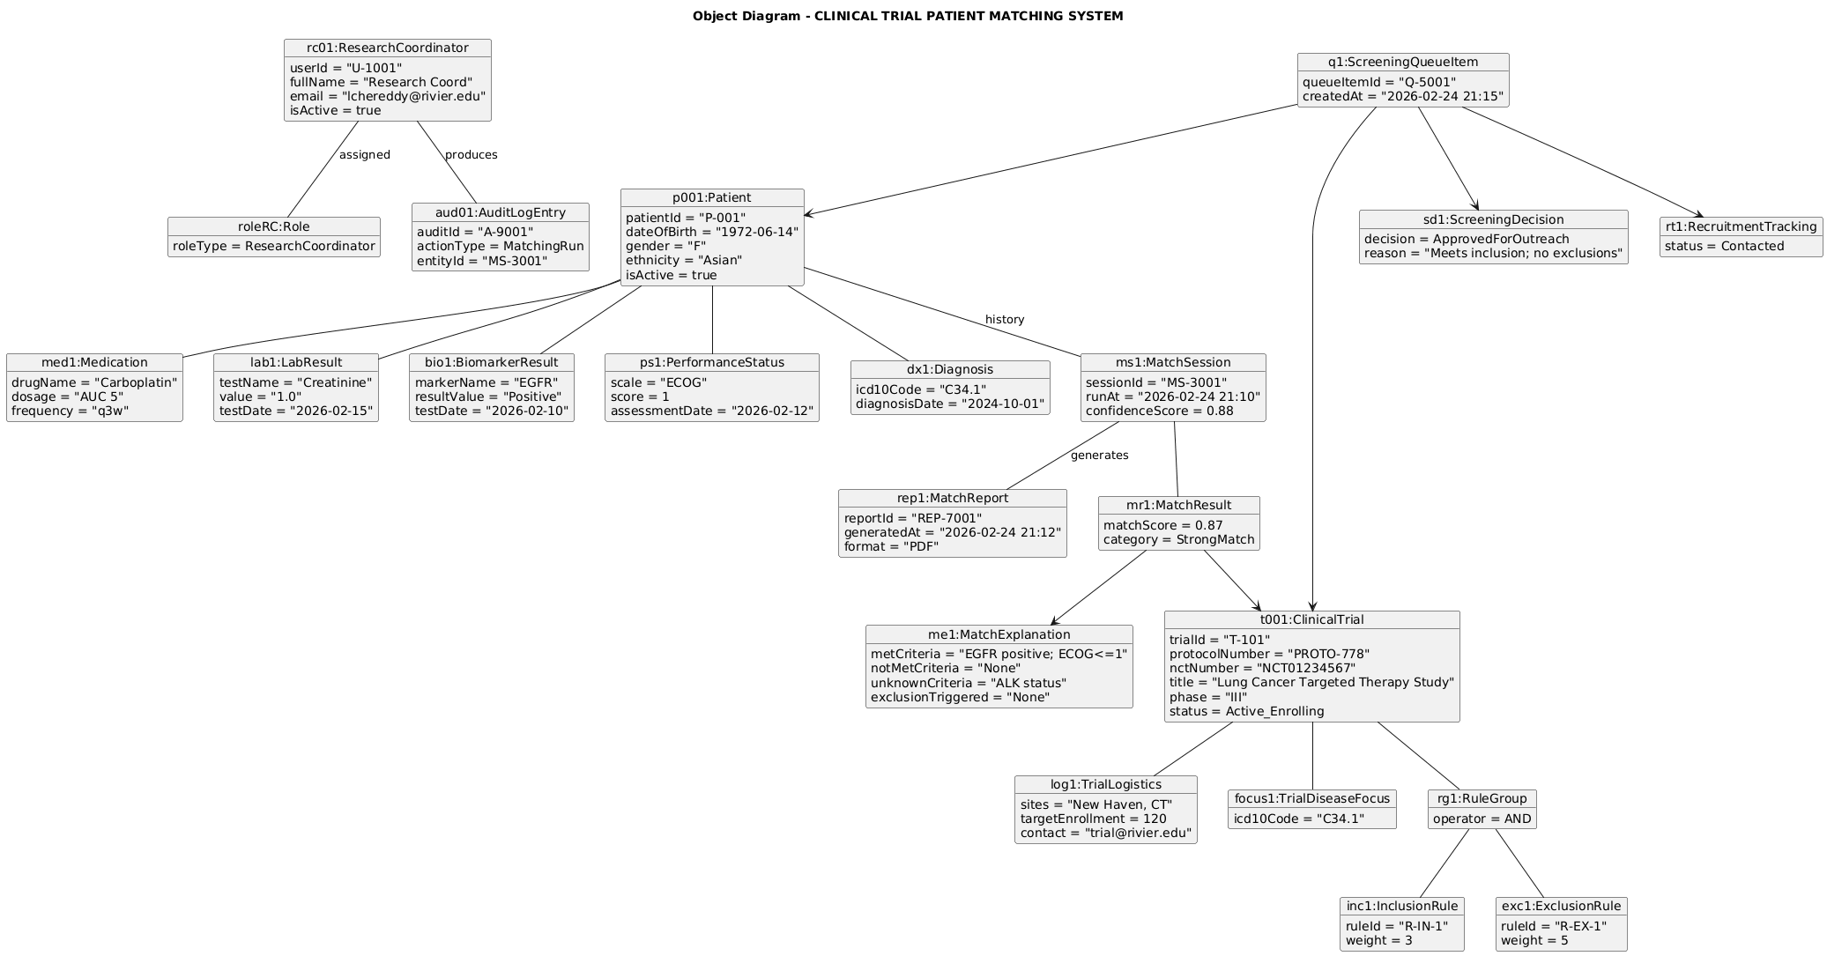
OBJECT DIAGRAM
Shows actual data instances (patient, trial, match result) in the system
Demonstrates how objects are connected during a matching session
Helps understand real system behavior with sample values
Useful for testing and validating system design
This object diagram represents real instances of classes during runtime and validates how the system behaves with actual data.

Slide 12
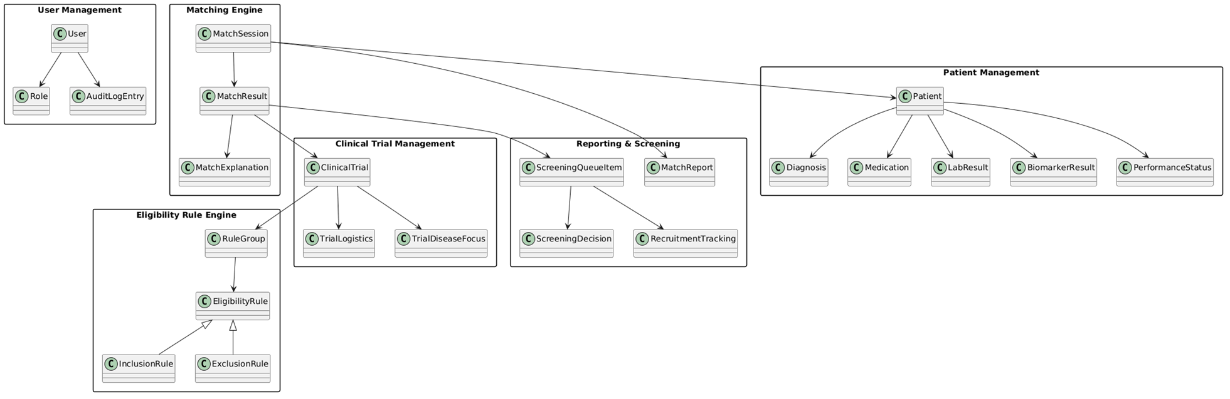
PACKAGE DIAGRAM
The package diagram organizes system components into layers and reflects the modular architecture used in implementation.

Slide 13
TECHNOLOGY STACK
Frontend: HTML, CSS (Bootstrap for responsive design)
Backend: Python (FastAPI / Flask framework)
Database: PostgreSQL (for structured data storage)
ORM: SQLAlchemy (database interaction and models)
API Communication: REST APIs (JSON-based communication)
Technology Justification:
• Fast API chosen for high-performance asynchronous API development
• PostgreSQL used for reliable and scalable relational data storage
• SQL Alchemy provides ORM support for clean database interaction
• Bootstrap used for responsive and user-friendly interface

Slide 14
CODE STRUCTURE
APP
app ( Main backend project folder )
api (API Layer – Controllers / Routes)
core ((Core Configuration & Utilities) )
Models / (ORM Models)
db / (Database Layer)
schemas/(Data Validation Layer)
Main.py
create_admin.py
env.py
venv
Static
Templates
.env
System Execution & Size:
• Entry Point: main.py initializes the application and API services
• Total Lines of Code: Approximately 2000-3000 lines.
• Layered Architecture:
API → Services → Models → Database
• Dependencies: API layer calls services, services interact with models and database

Slide 15
CODE STRUCTURE
Folder / File | Contains | Description
App | All backend code | Main project folder
api | auth.py, users.py, patients.py, trials.py, matching.py | Handles all API routes and user requests
Core | config.py, security.py, email.py, utils.py | Configuration, security, and helper functions
db | session.py | Database connection setup
Models | models.py | All database tables and entity classes
Schemas | schemas.py | Data validation and request/response models
Services | matching.py, reports.py | Business logic like matching and reports
Main.py | -- | Application entry point (runs the system)
Create_admin.py | -- | Script to create admin user
env.py | -- | Loads environment settings
venv | -- | Virtual environment for dependencies
Static (inside app) | -- | Static files used in backend
Templates | index.html | Frontend UI (login page)
Static(root level) | images, uploads | Global static resources
.env | -- | Environment variables (DB, keys)
requirements.txt | -- | List of project dependencies
test.db | -- | Database file (SQLite)

Slide 16
CODE to user requirement mapping
Patient Management
Implemented in patients.py and models.py
Example: Patient diagnosis (E11) stored in Diagnosis table
Clinical Trial Management
Implemented in trials.py
Example: Trial created with inclusion rule (Diagnosis = E11)
Matching Functionality
Implemented in services/matching.py
Example: System compares patient diagnosis with trial rule and calculates score
Result Generation
Implemented using API and UI
Example: Displays confidence score, match category, and criteria met
Mapping to Use Cases:
Patient Management use case implemented in patients.py
Trial Management use case implemented in trials.py
Matching use case implemented in services/matching.py
These directly correspond to functionalities defined in the use case diagram

Slide 17
Class diagram impact on code
Class Diagram to Code Structure
Classes mapped to Models
Defined in models.py
Example: Patient, ClinicalTrial, MatchResult classes
Relationships implemented
One-to-many relationships used
Example: One Patient → Multiple Diagnoses
Matching design applied
Classes used in matching logic
Example: MatchSession and MatchResult used in matching.py
Layered architecture followed
Separate folders for API, services, and models
Example: API handles requests, services handle logic
The class diagram directly influenced database schema design and object-oriented implementation in models.py.

Slide 18
references
Dennis, A., Wixom, B. H., & Tegarden, D. (2020). Systems analysis and design (7th ed.). Wiley.

Slide 19

THANK YOU
Questions & Discussion!!!
LIKITHA CHOWDARY CHEREDDY | lchereddy@rivier.edu

